Slide 1
LS-OPT Set-up

Slide 2
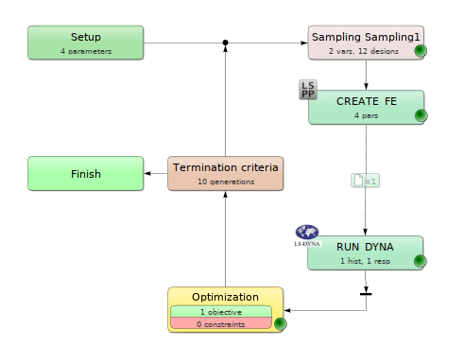


Slide 3
Simulation time
3D computationally expensive
Computational time full 3D – 64 CPU -> 12h
10 iterations, population size 12 -> ~5 days
Approximate using (semi-)2D simulations
Simulation time ~1 min
Optimization time ~15 min
Plug in optimized 2D parameters in full 3D model

Slide 4
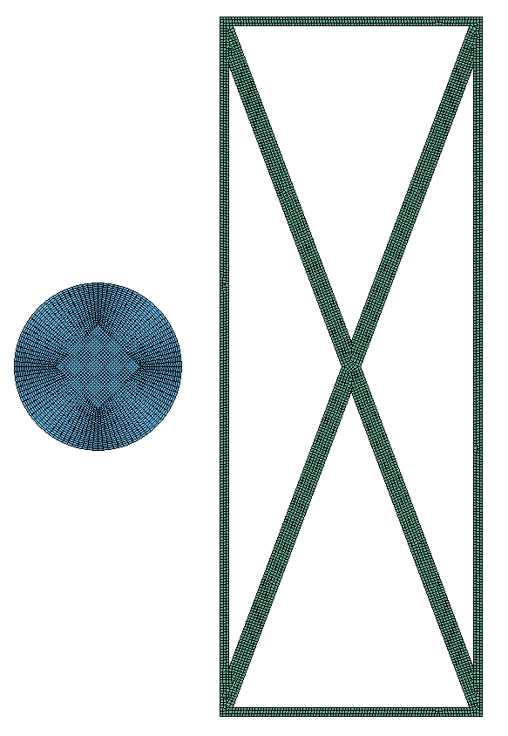
Model
Minimization w.r.t. residual velocity
Minimization w.r.t. kinetic energy
Reference: Monolithic shield with equal mass
Material used: AA6070-O
We tried AM but unstable results (too ductile)

Slide 5
LS-OPT RESULTS

Slide 6
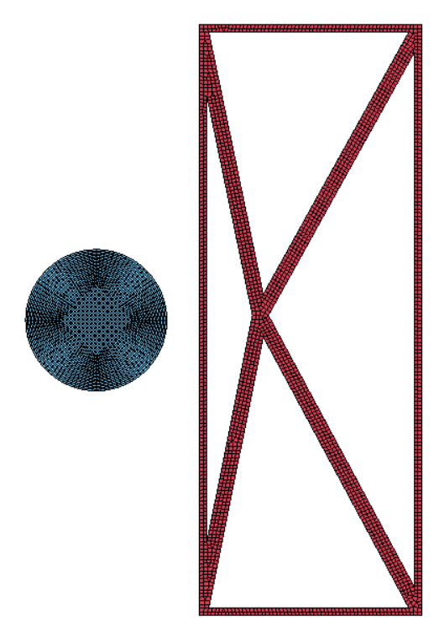
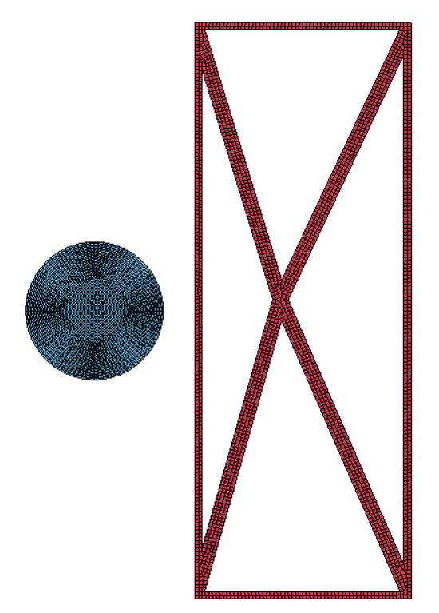
2D
Optimization w.r.t. residual velocity
(x,y) = (4.0833, 0.336)
2. Optimization w.r.t. kinetic energy
(x,y) = (5.915, 0.7785)
Inconsistent optimization results
Depending on initial input, x can be:
Close to lower boundary
Close to upper boundary
Energy results unreliable
y
y
x
x

Slide 7
2D
Residual velocity
Kinetic energy

Slide 8
3D - unoptimized

Slide 9
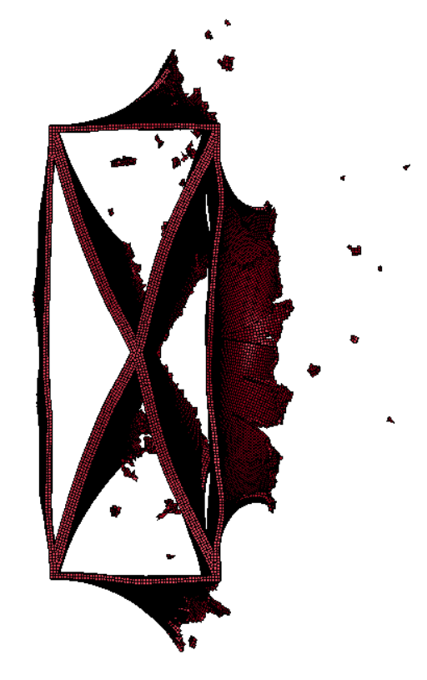
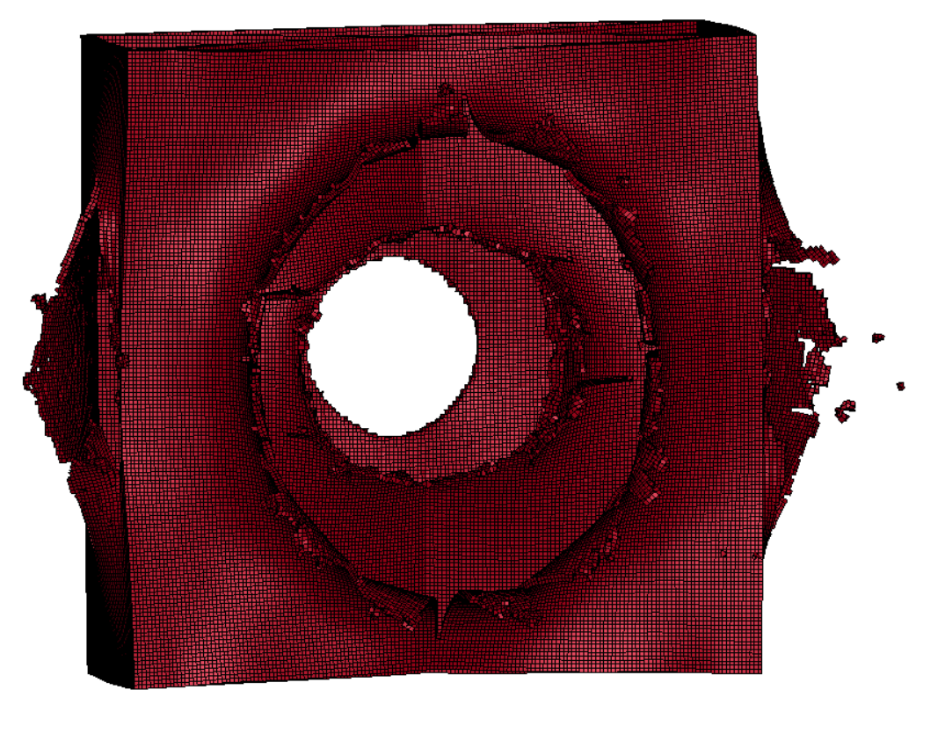

Slide 10
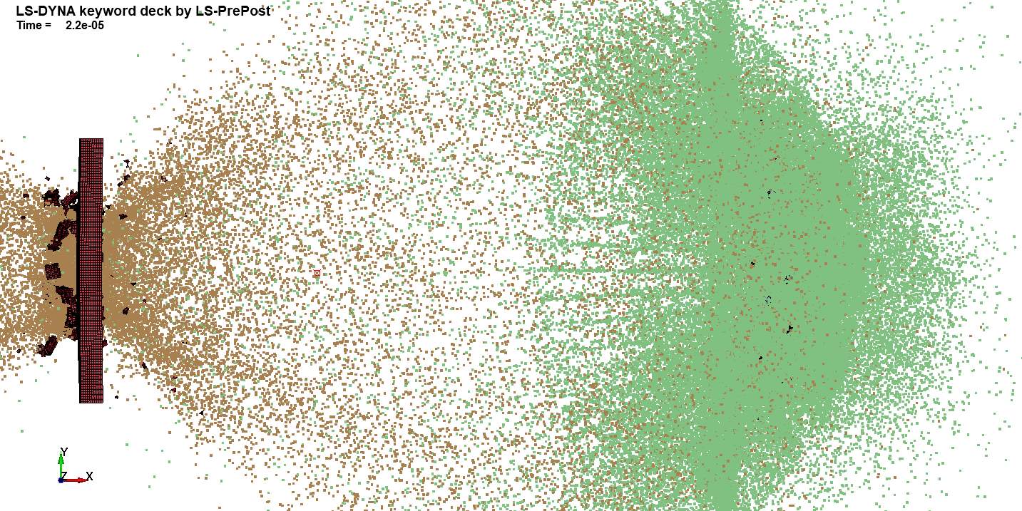
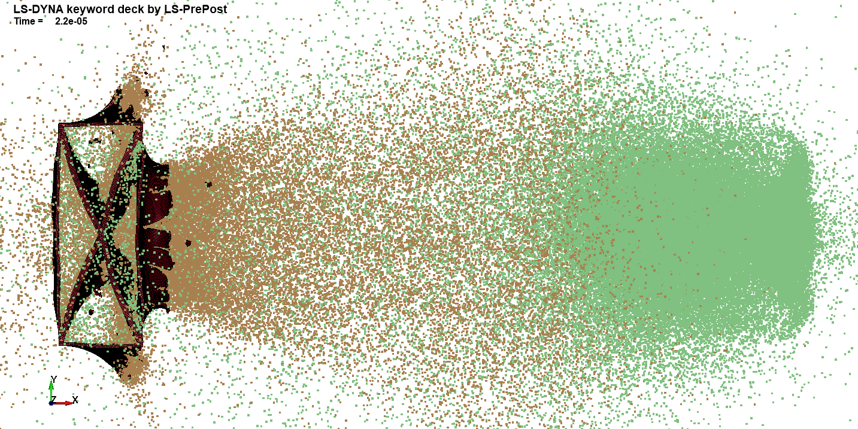
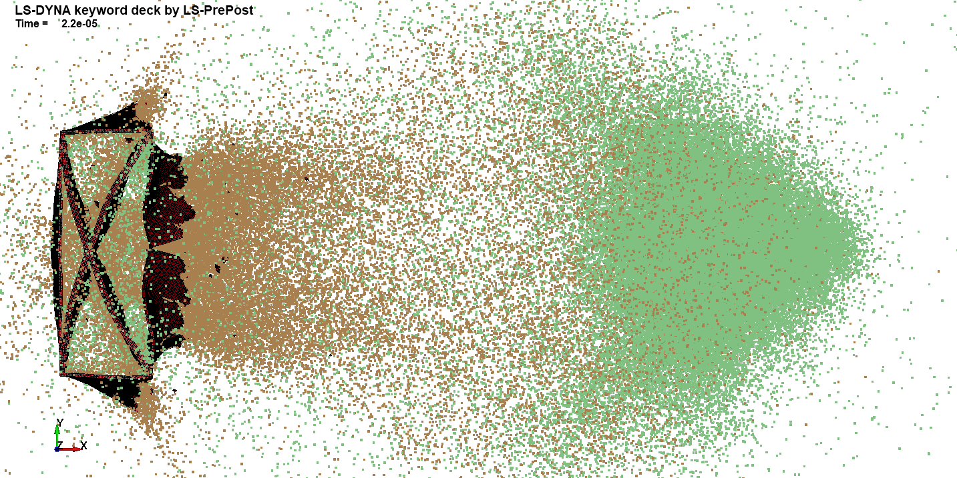
3D – comp.
Monolithic
Unoptimized X
Optimized X

Slide 11
2D
3D

Slide 12
Conclusions
Optimization with LS-Opt works
Comparison between similar looking designs possible
Difficult to optimization w.r.t. energy. Inconsistent results
Unable to validate optimized model to 2D and 3D monolithic model.
Next steps
Dual wall set-up. Geometry optimization of second wall
Write-up

